Slide 1



Slide 2
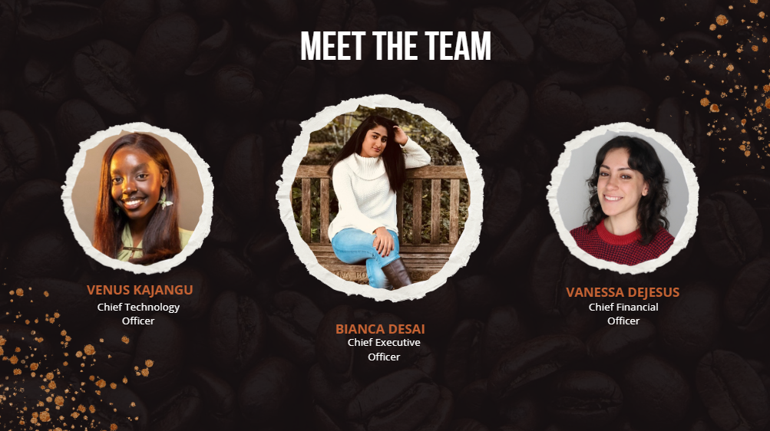

Slide 3
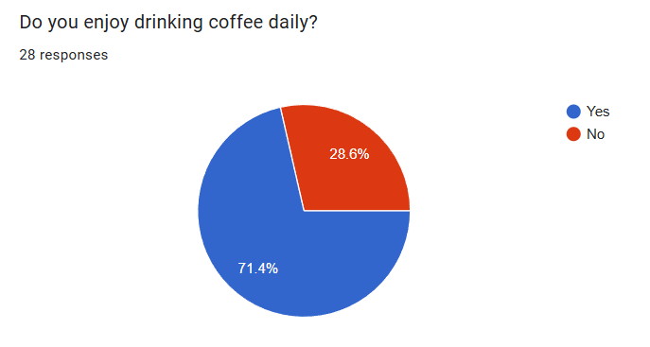

Slide 4
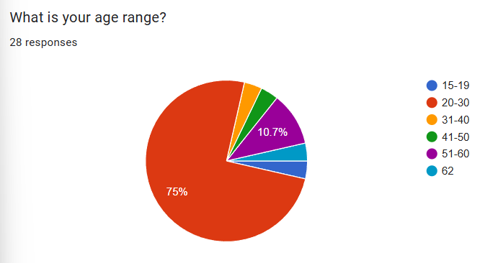

Slide 5
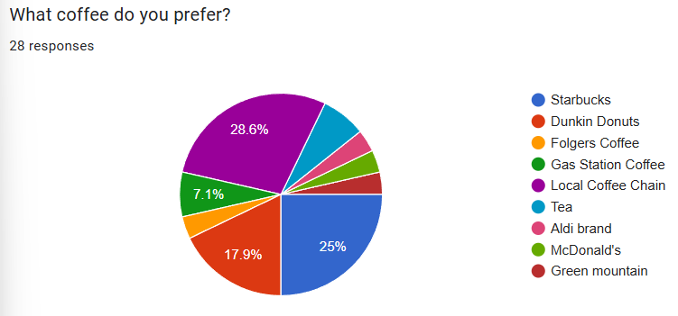
The most popular coffee we received in our responses was from a local coffee chain, with Starbucks and Dunkin Donuts falling shortly behind.

Slide 6
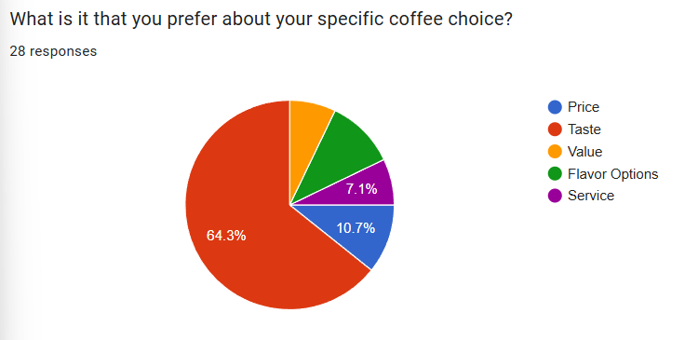
An overwhelming majority of people care most about the taste of coffee, with the other options almost equally making up the rest.

Slide 7
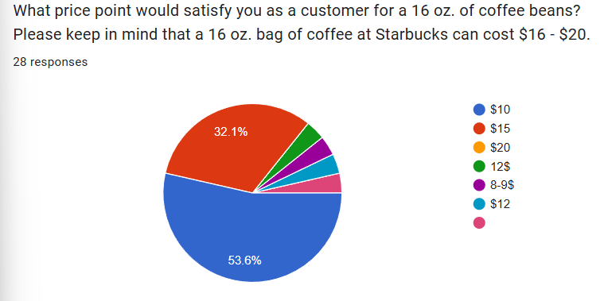
We were surprised to see that over half of our responses showed that people would pay $10 for 16 oz. of coffee beans knowing that Starbucks charges around $16-20 for the same amount

Slide 8
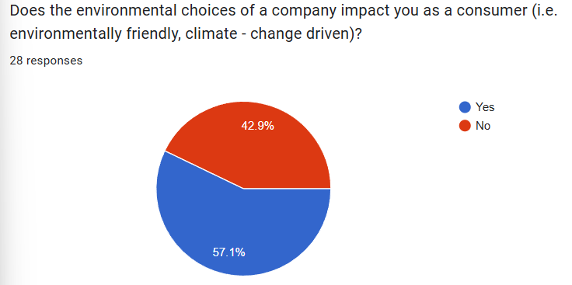

Slide 9
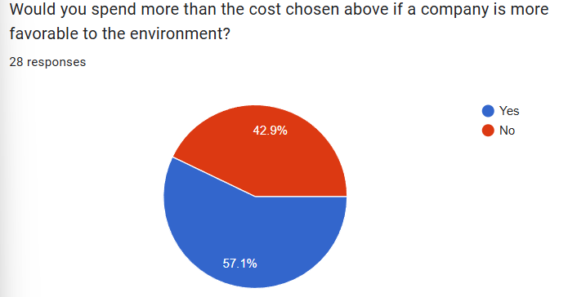

Slide 10
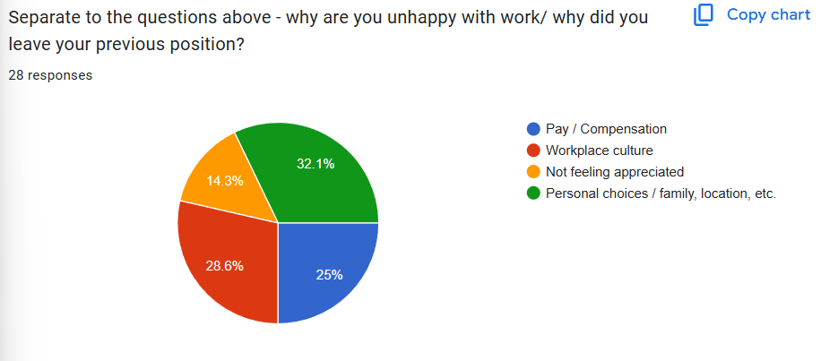
We found that most people were unhappy with work or left due to personal choices, but workplace culture and pay/compensation was not far behind.

